Slide 1

Week 3 Review
Alessio Illari, Gursimran Kainth

Slide 2
ZDC Simulation Review Week 2
Generated 3D hitmaps for simulated data for different particles to visualize what the hits in the ZDC look like
Located and were able to edit both the old and new ZDC geometry files
Objectives were to work on photon angle study and see how the location of pion (along the proton beampipe) affects the distance between the photons

Slide 3
ZDC Simulation: Simulation and Visualization
Problem with simulation software that only particles in tracking region had MCParticle information
Fixed by extending tracking region: we can now observe complete showers of lambda in the ZDC
Found a way to force simulation software to produce only lambda->pi0+n
Started work with EIC software team to display simulated data on new ePIC visualization software Firebird
This should allow us to visualize the difference in showers between ZDC with WSi and without

Slide 4
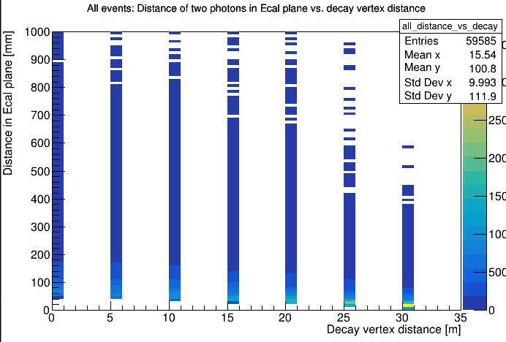
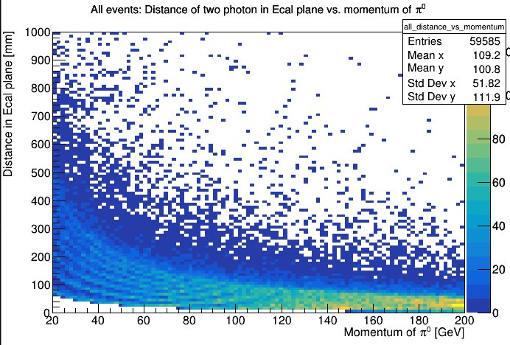
ZDC Simulation: Pion Distance Study
Created pions (20 to 200 GeV) at 5m intervals along the p beam pipe (0m, 5m, 10m, 15m, 20m, 25m, 30m)
The distance of the two gamma in ecal plane vs pion energy and vs pion decay distance

Slide 5
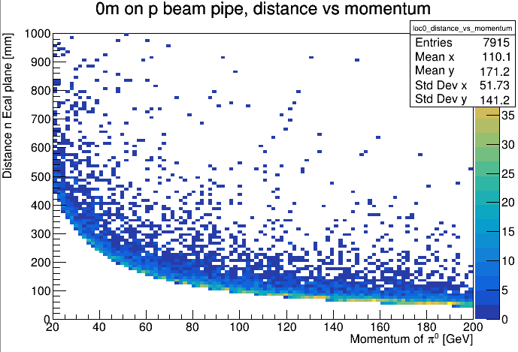
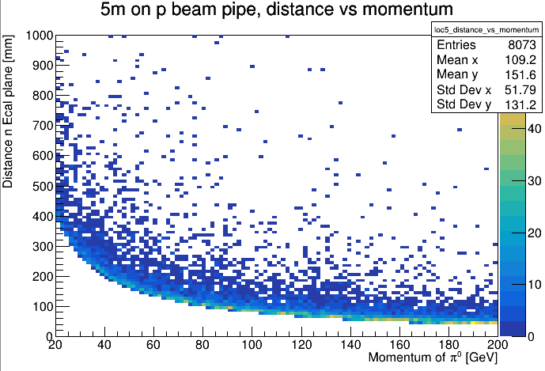
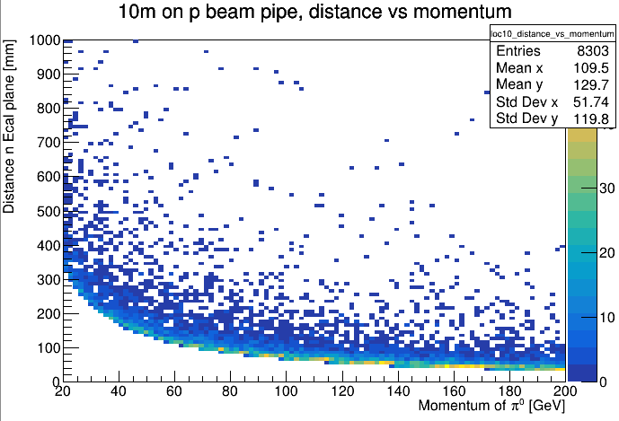
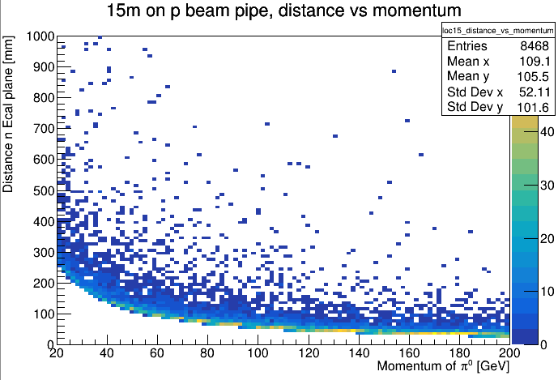
Pion Plots 1

Slide 6
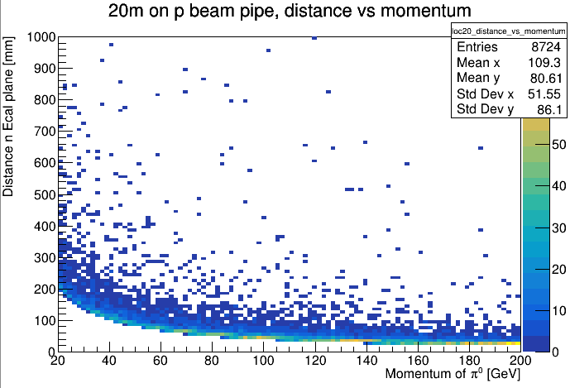
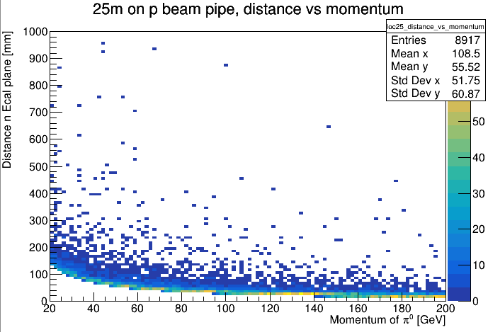
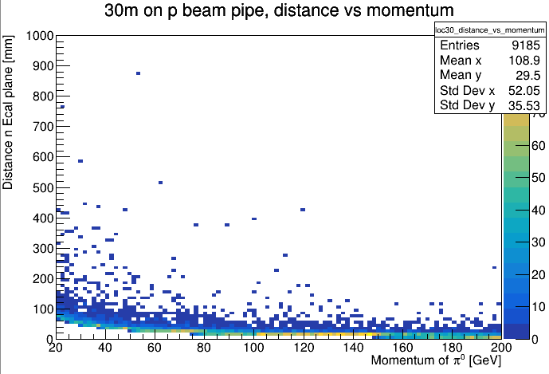
Pion Plots 2

Slide 7
ZDC Simulation: Photon Angle Study
Simulated pion events with momentum ranging from 40-200GeV to see relationship between the opening angle of the photons and the pion momentum
As expected, the higher the pion momentum the closer the photons are so the more difficult it is to distinguish between the clusters
Based on simulated Lambda data though (see in a later slide) the pion is not expected to have very high momentum so we should be able to distinguish between the clusters

Slide 8
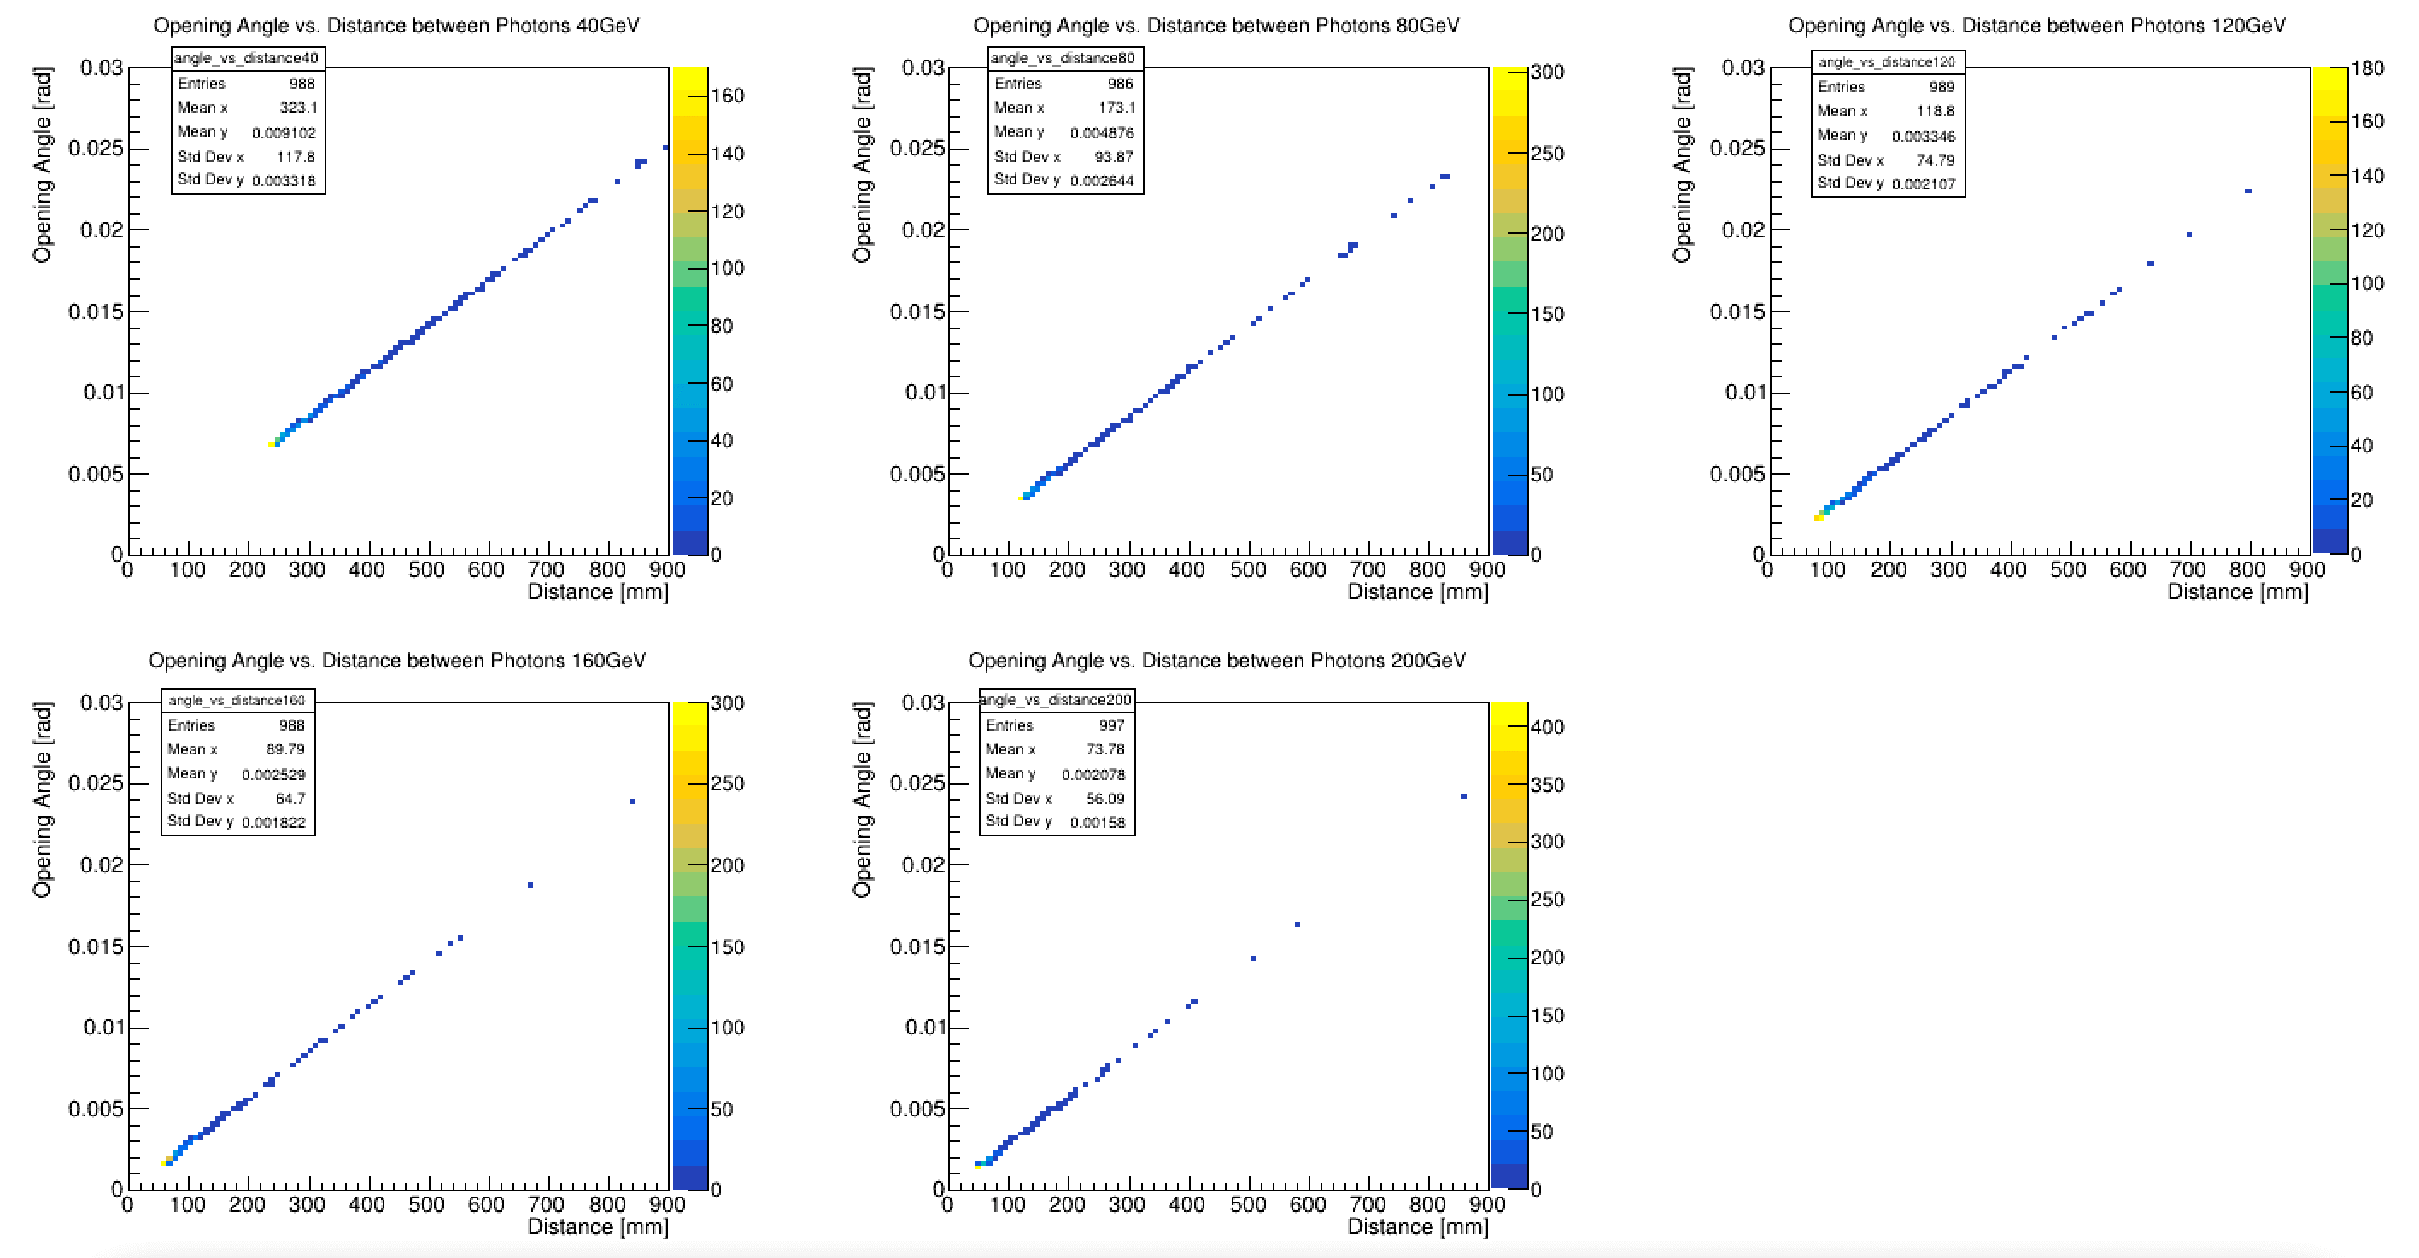
ZDC Simulation: Photon Angle Study

Slide 9
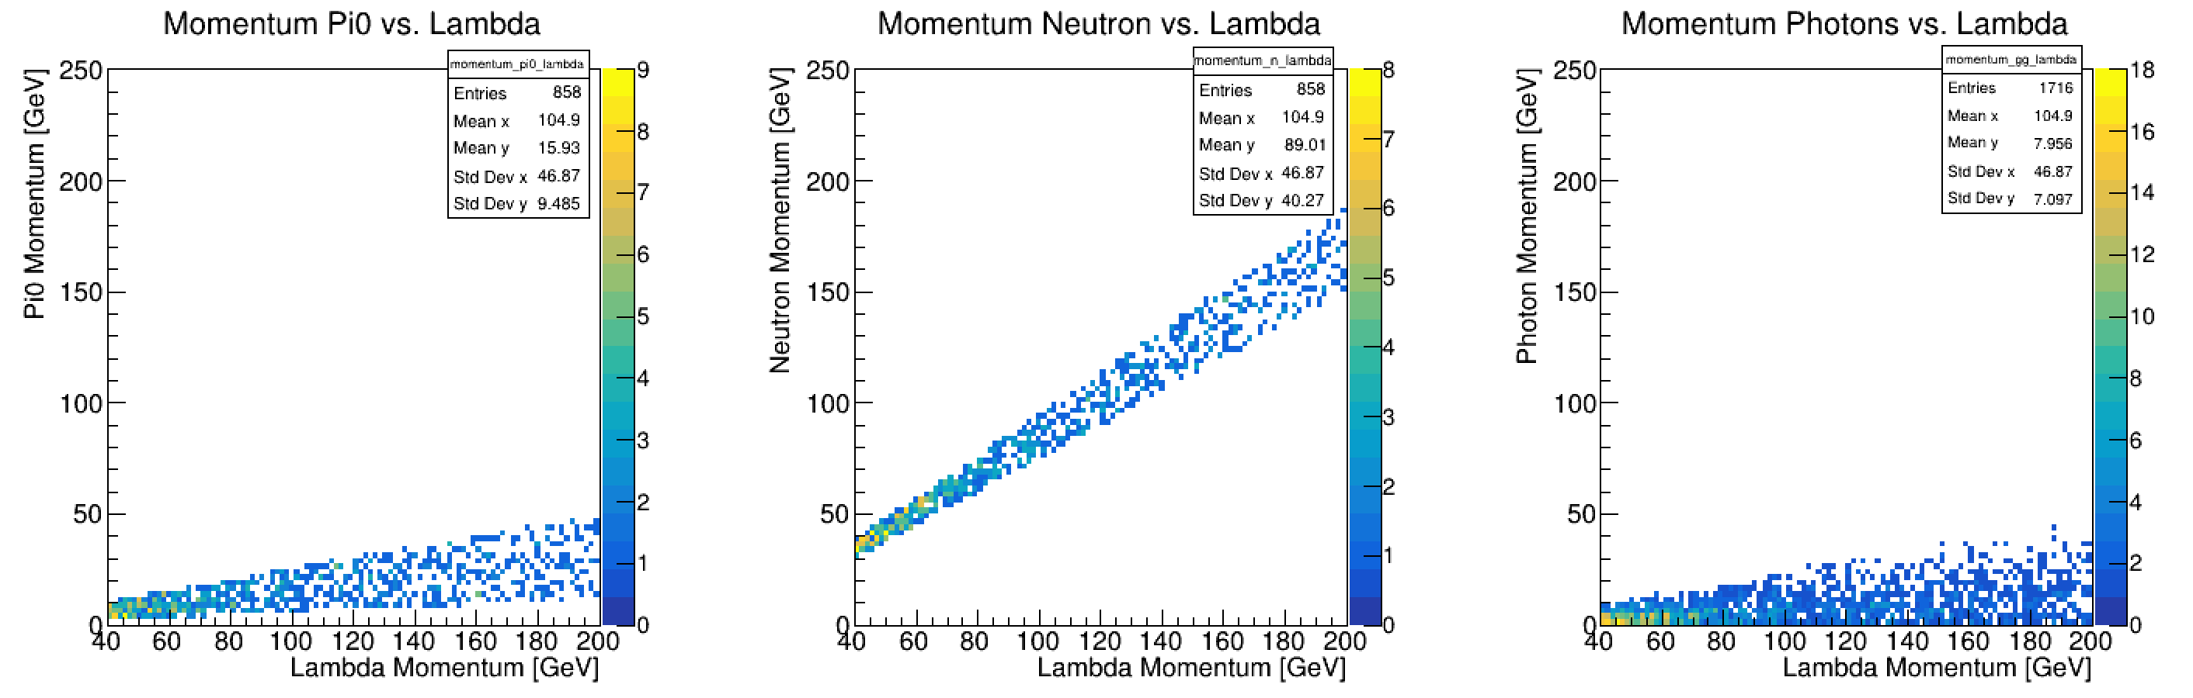
ZDC Simulation: Lambda Study
Started simulating Lambda data to study the resolution of double photon + neutron decay

Slide 10
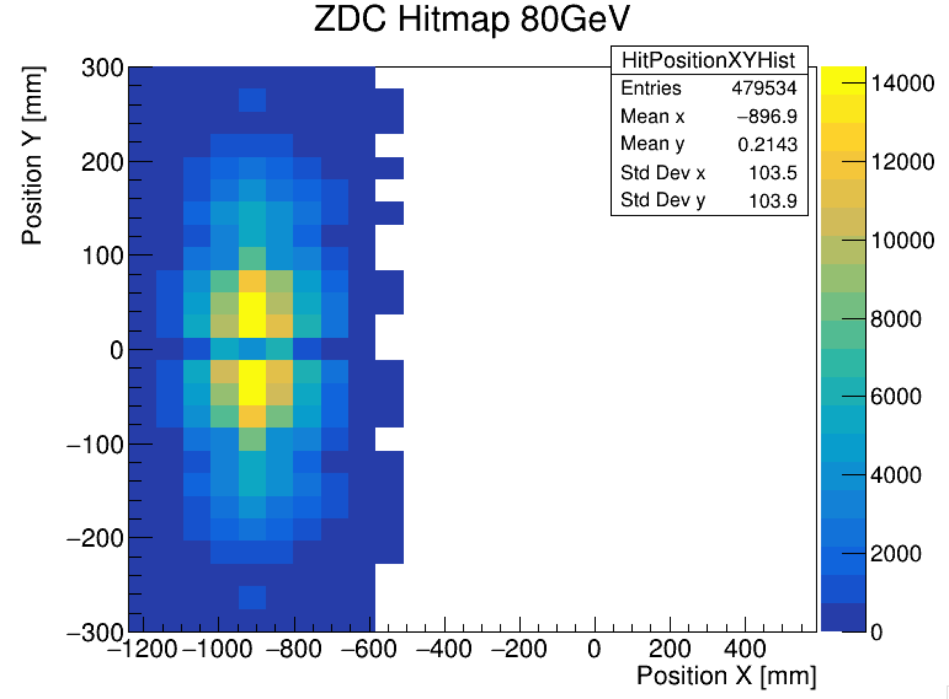
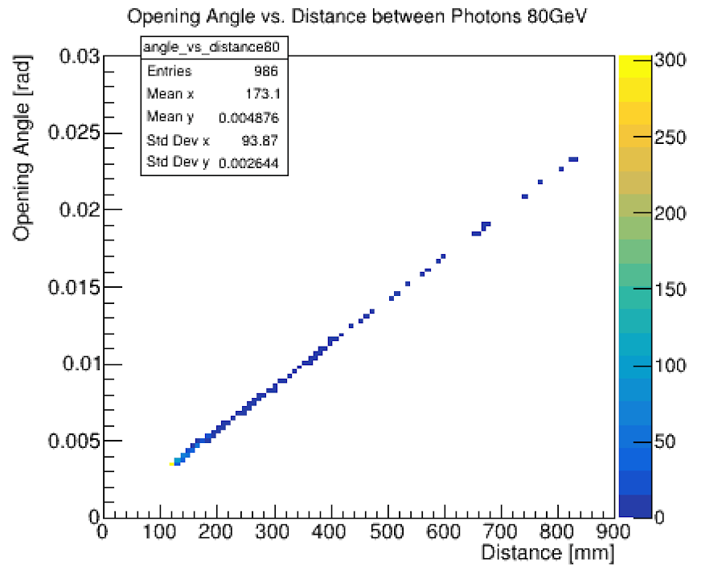
ZDC Simulation: Lambda Study

Slide 11
ZDC Simulation: WSi Geometry
Design has not changed, implementing the WSi layers exactly as it was in original ZDC
Space was made by removing 5 layers from the front of the Hcal
Simulation readout works, hits positions are provided
Plots for various particles and their hits in ZDC

Slide 12
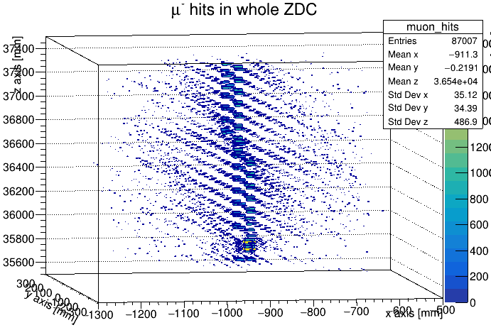
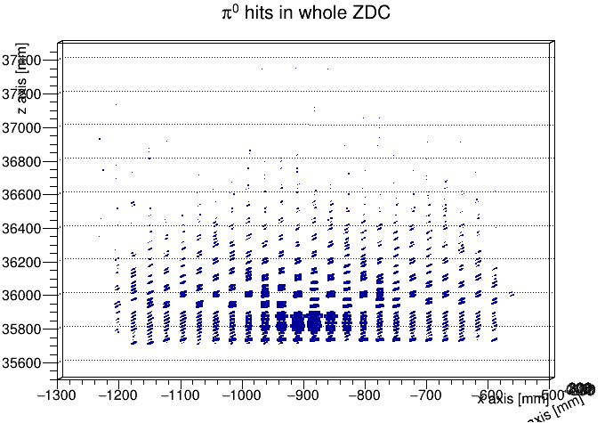
WSi Geometry Plots 1

Slide 13
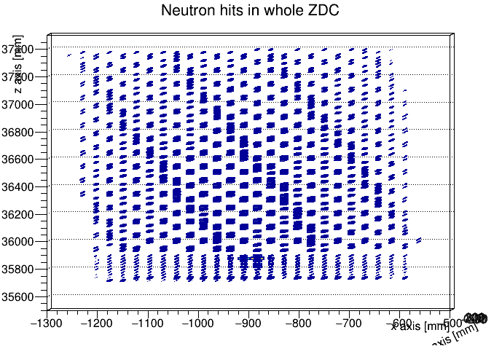
WSi Geometry Plots 2

Slide 14
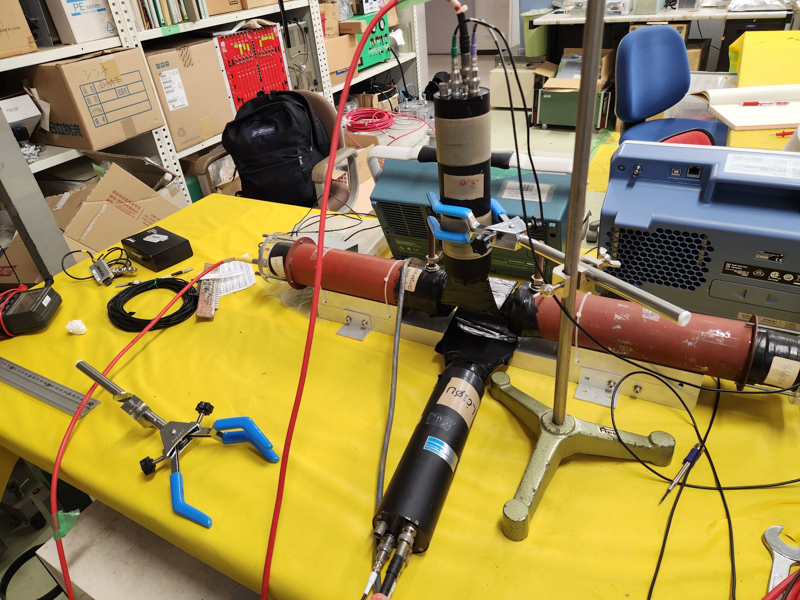
Hardware: Plots for Coincidence Study
We took 5 sets of data
Varied height and angle
Active ch2, 3 and 4
Ch1 was too noisy

Slide 15
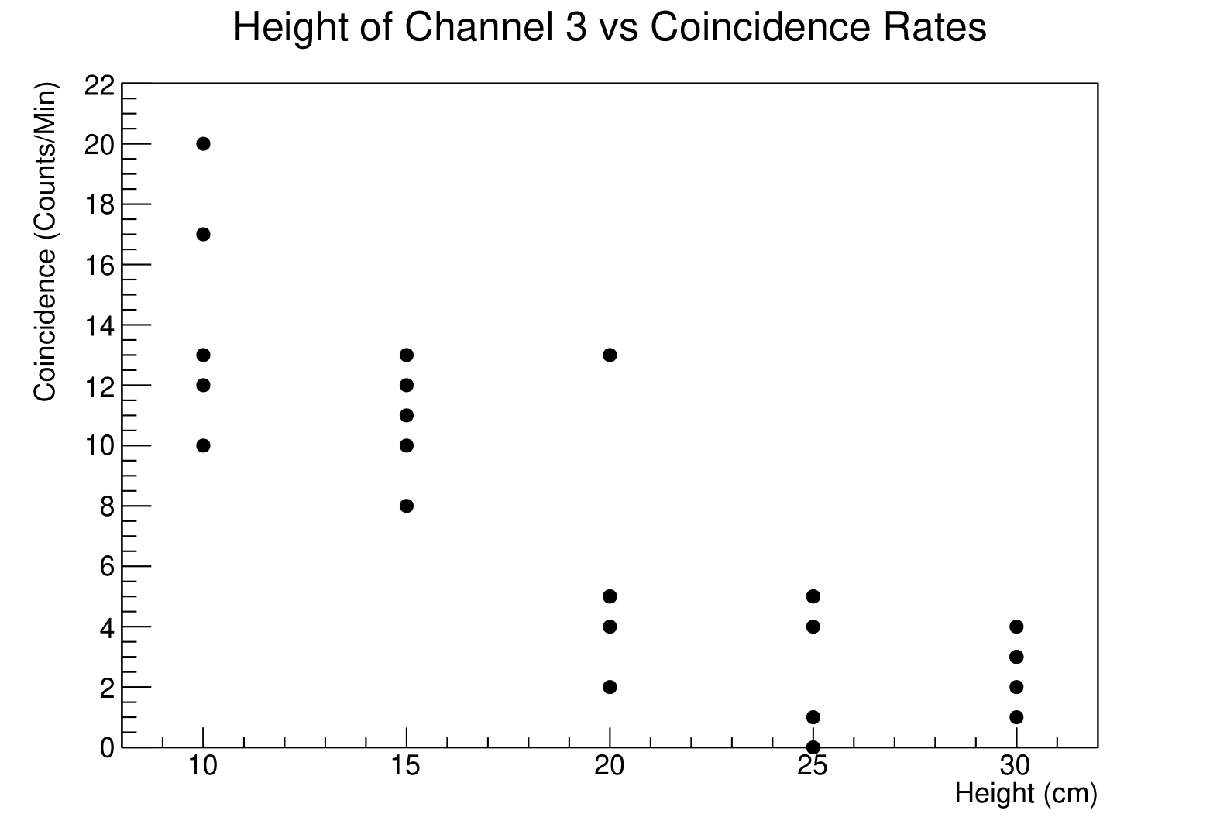
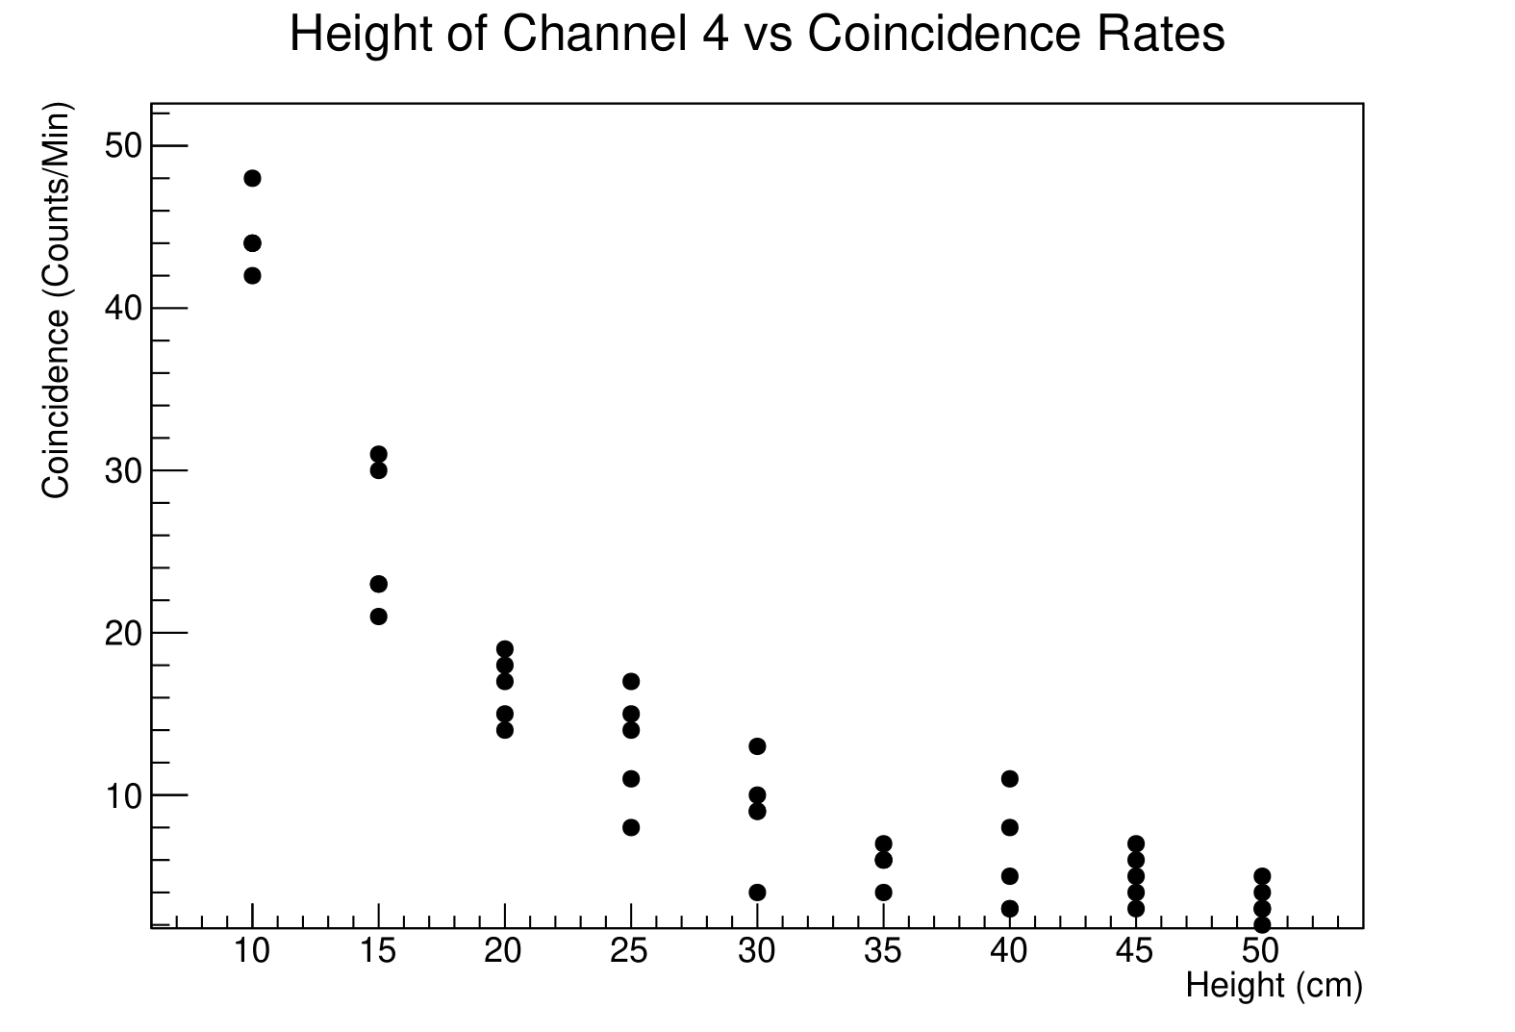
Coincidence Study Plots 1

Slide 16
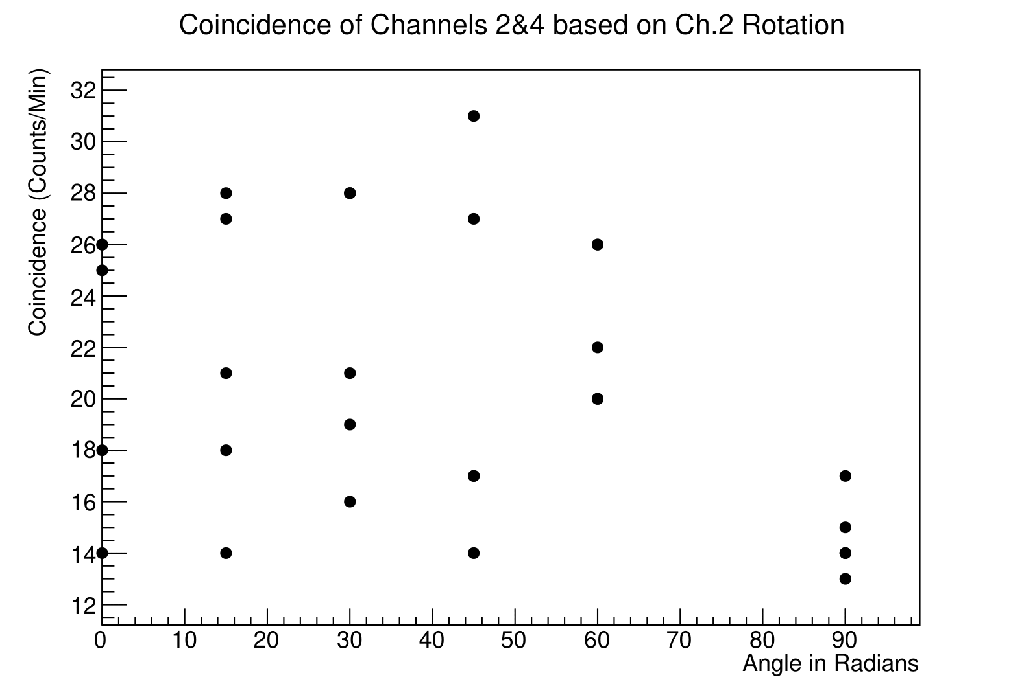
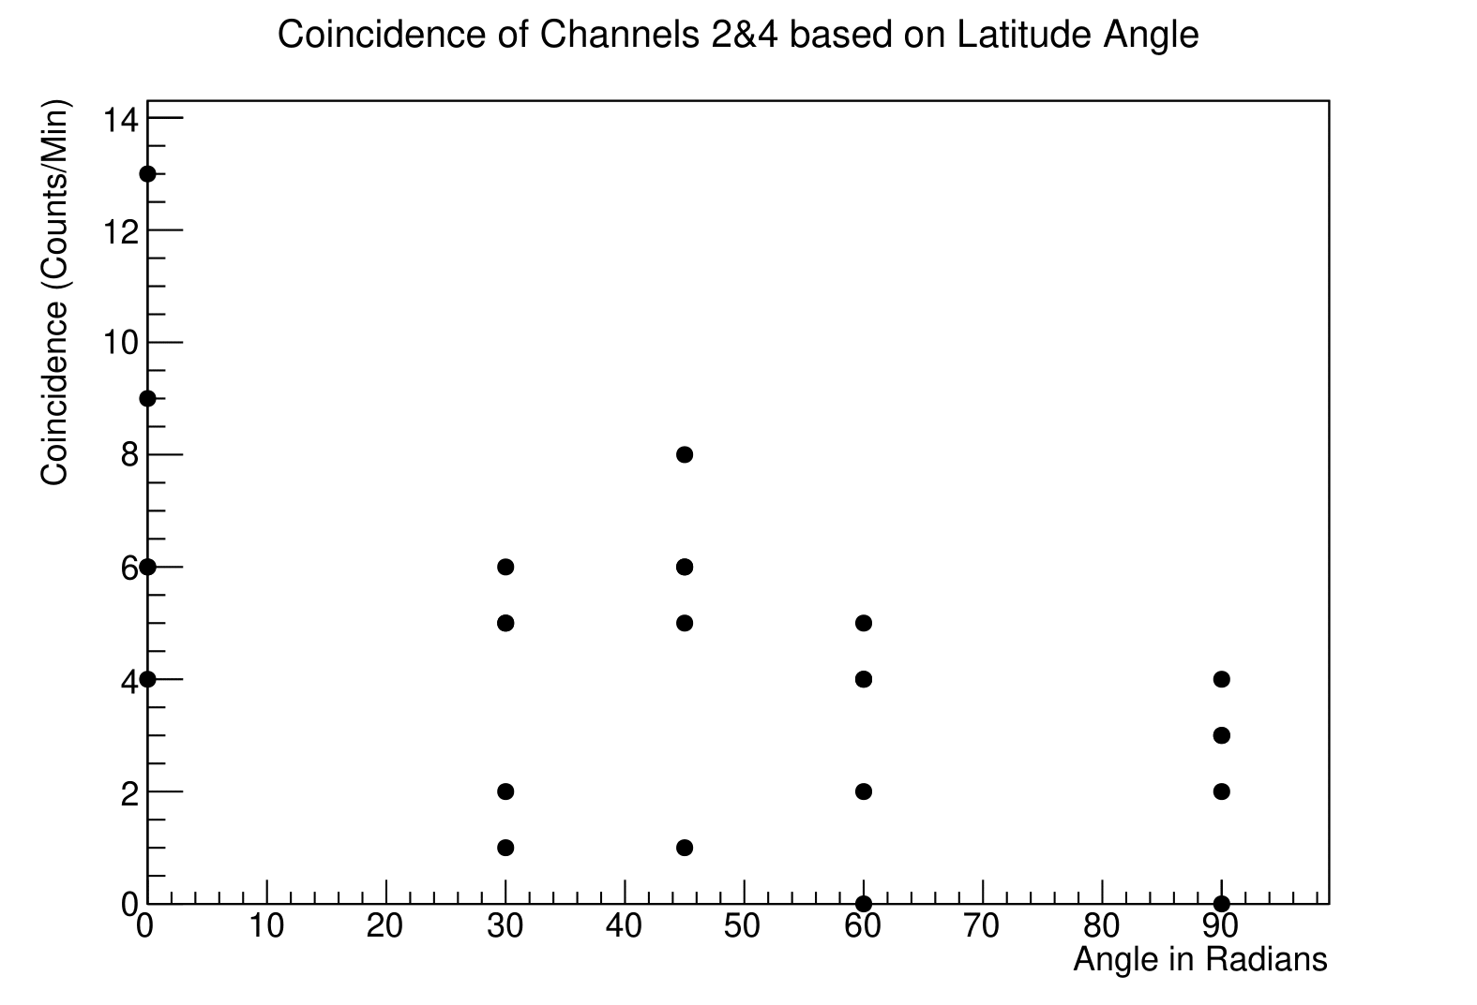
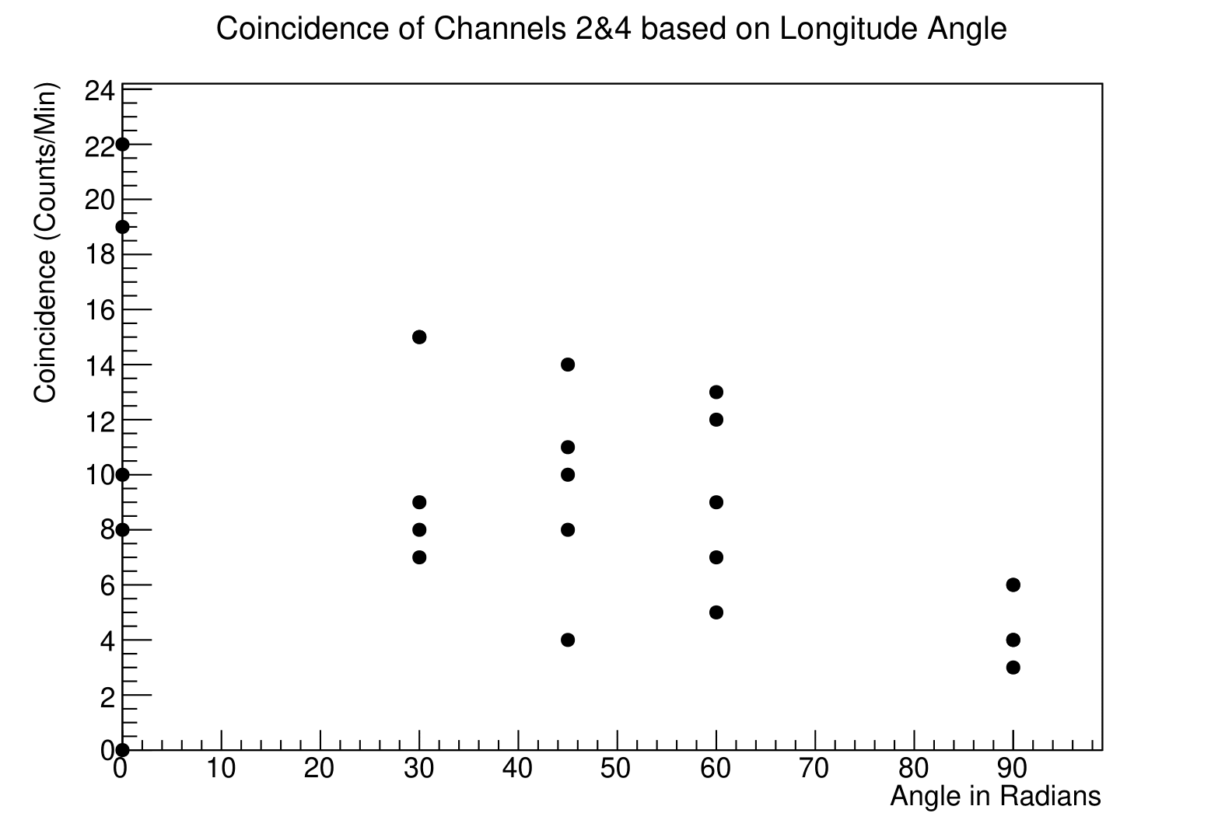
Coincidence Study Plots 2

Slide 17
TPC Construction: General Assembly
We disassembled several TPCs and reconstructed one
Resoldered the wires and resistors on the cage
Soldered the circuit together
Assembled GEM and placed it in cage
Currently waiting for Prof. Taku's next free day to installed alpha source, close TPC and start pumping with N2
Next steps are set up the DAQ and start collecting data

Slide 18
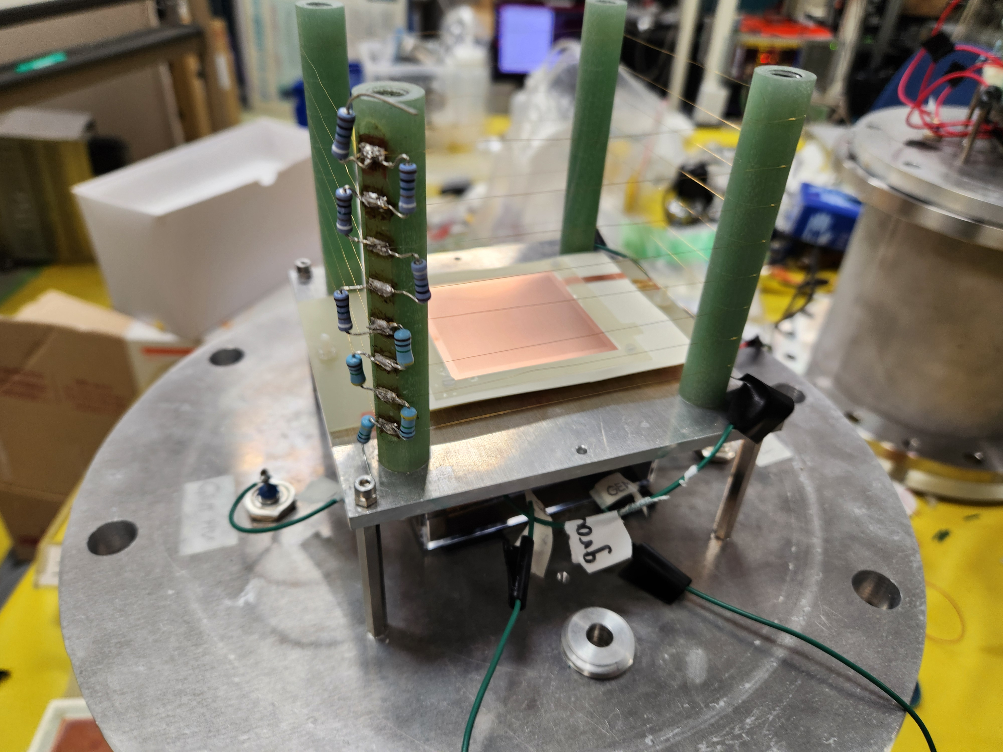
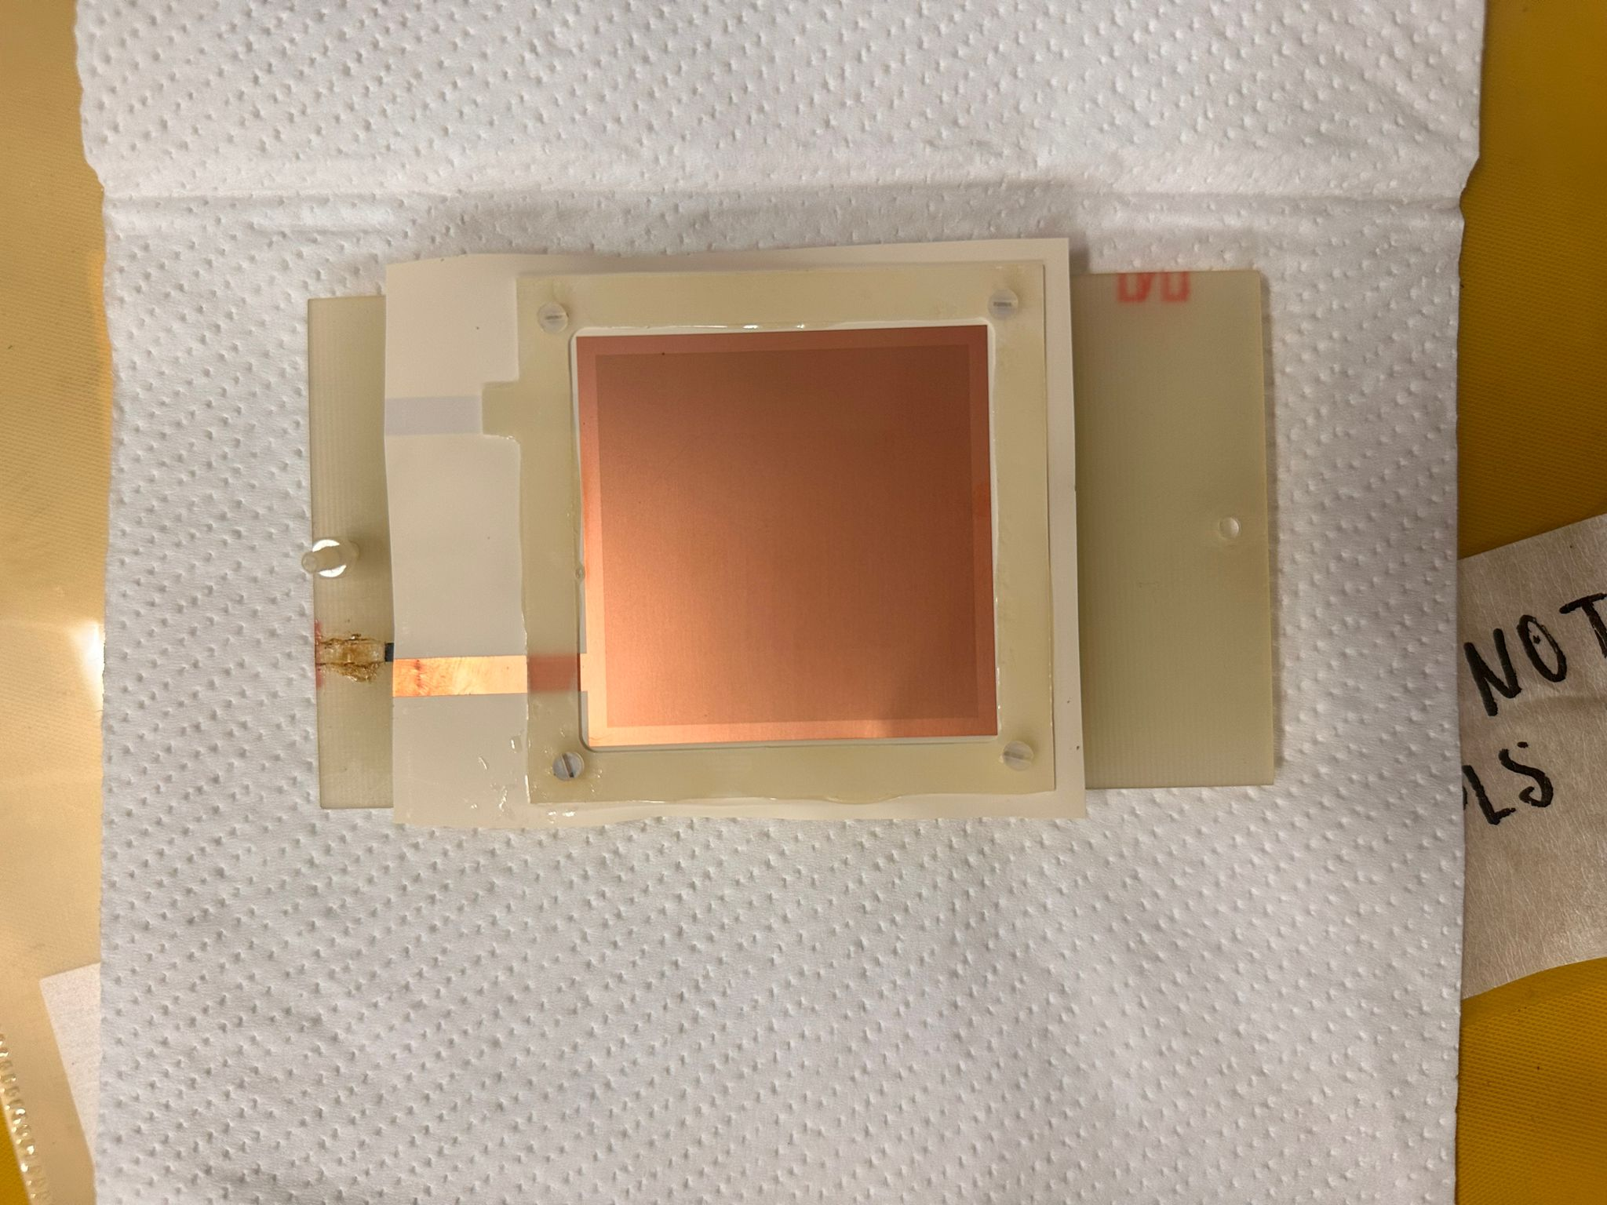
TPC Construction: Photos

Slide 19
Goals for this week
Note: G will be back in America until July 2nd
Determine abstracts for APS-DNP, deadline is 8th July (2 weeks)
ZDC Simulation:
Determine for what lambda energies/decay lengths do we see 2gamma + n in ZDC AND can we distinguish them
TPC Hardware:
Finish constructing
Prepare DAQ
Start taking data

